Slide 1

Create by Bayanov Zhangir
SE-2001

Slide 2

Introduction
Building Management System is a computer system
that allows you to manage the physical processes of a building

Slide 3

My project
The goal of my project is to show the connection of internal BMS systems

Slide 4
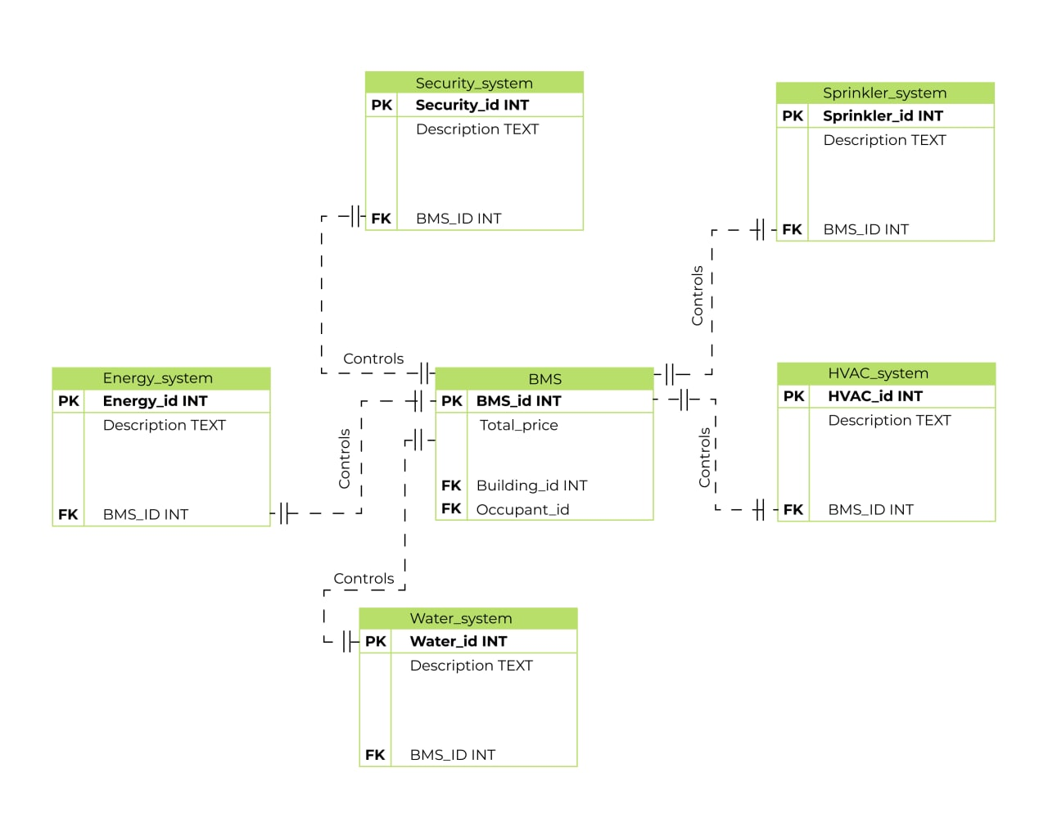

Entity-Relationship diagram

Slide 5
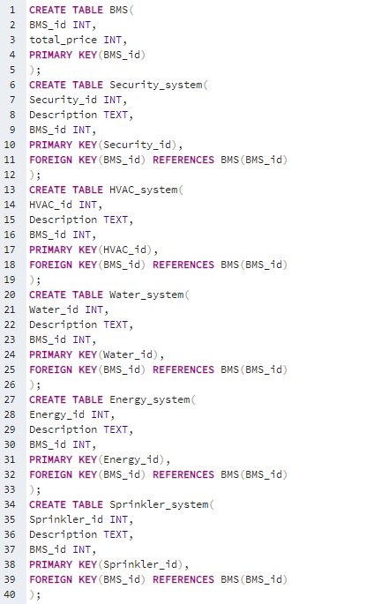
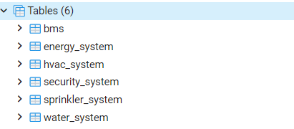
SQL code
I used PgAdmin 4 to write the code

Slide 6
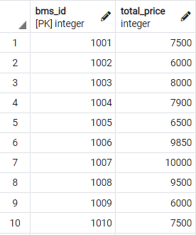
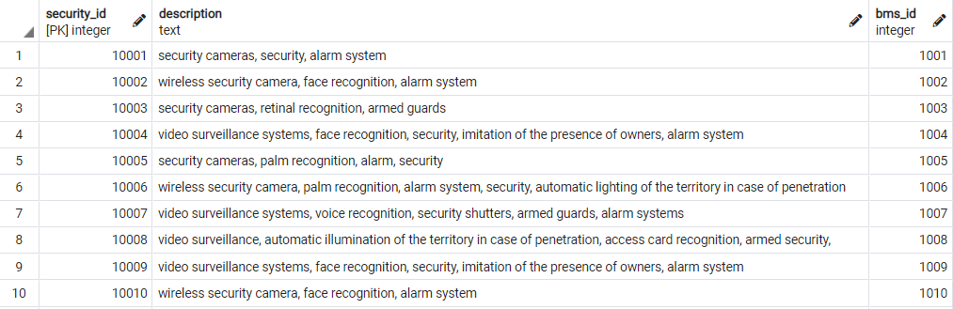
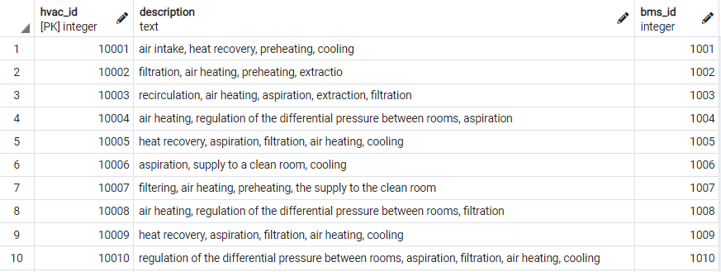
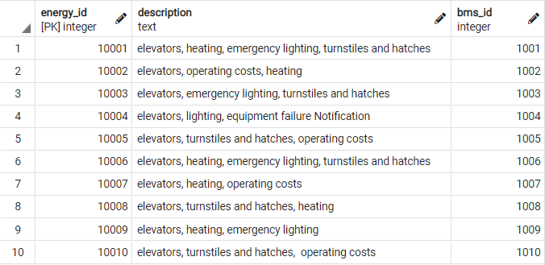
the first part of the tables

Slide 7
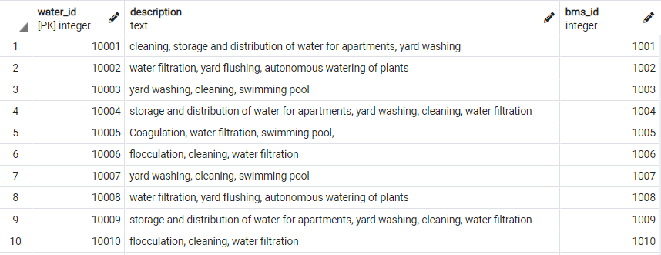
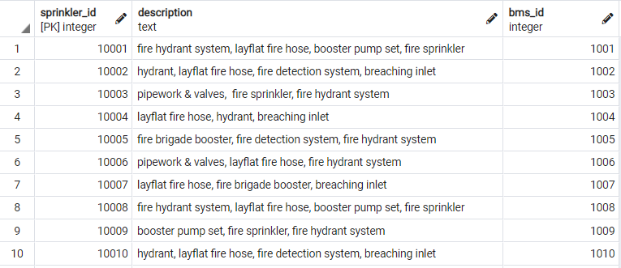
the second part of the tables

Slide 8
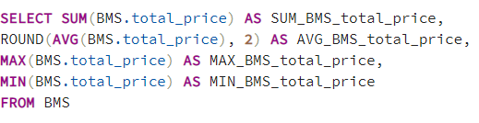
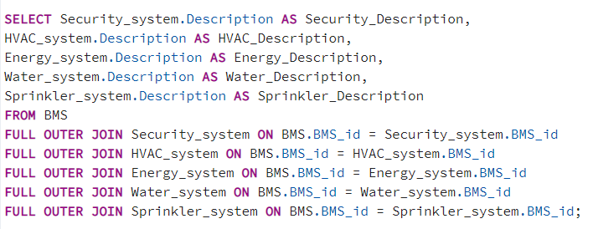
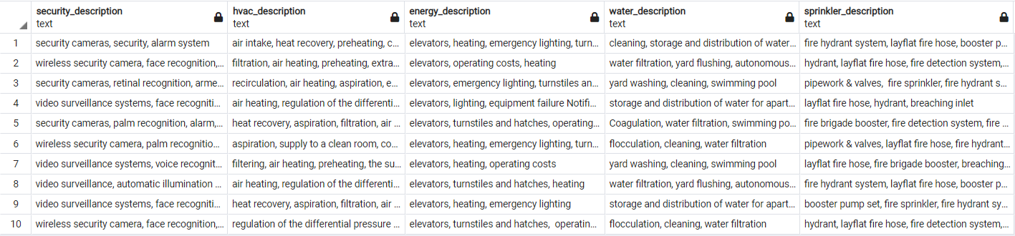
Select query

Slide 9

THE END
go your own way Stalker

